Slide 1

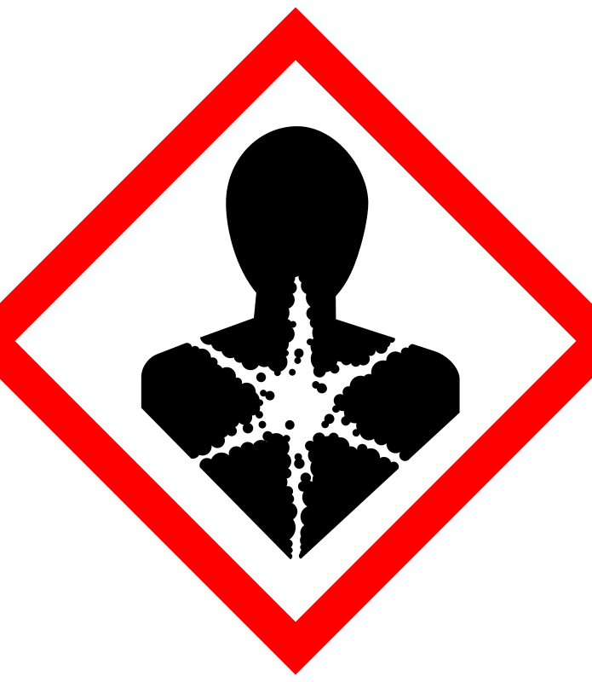
Reproductive toxicity
Reproductive toxicity is a hazard associated with some chemical substances, which interfere in some way with normal reproduction; such substances are called reprotoxic
They may adversely affect sexual function and fertility in adult males and females, as well as causing developmental toxicity in the offspring.
Many drugs can affect the human reproductive system. Their effects can be
desired (hormonal contraception),
a minor unwanted side effect (many antidepressants) or
a major public health problem (thalidomide).
Toxicology studies use animal models to evaluate adverse effects on the reproductive system. Studies must be carefully designed with appropriate exposure routes (e.g. oral, inhalation or dermal) and dosages to provide data that is useful for predicting human exposure effects.

Slide 2
Teratogens
One well-known group of substances which are toxic for reproduction are teratogens – substances which cause birth defects
(S)-thalidomide is possibly the most notorious of these
Thalidomide, sold under the brand name Thalomid among others, is a medication used to treat a number of cancers including multiple myeloma, graft-versus-host disease, and a number of skin conditions including complications of leprosy. While it has been used in a number of HIV associated conditions, such use is associated with increased levels of the virus. It is taken by mouth.
Another group of substances which have received much attention (and prompted some controversy) as possibly toxic for reproduction are the so-called endocrine disruptors.
Endocrine disruptors change how hormones are produced and how they interact with their receptors

Slide 3
Endocrine disruptors are classified as
Estrogenic,
Anti-Estrogenic,
Androgenic
Anti-androgenic
Each category includes pharmaceutical compounds and environmental compounds
Estrogenic or androgenic compounds will cause the same hormonal responses as the sex steroids (estrogen and testosterone)
Anti-estrogenic and Anti-andogenic compounds bind to a receptor and block the hormones from binding to their receptors, thus preventing their function
A few examples of the many types of endocrine disruptors are trenbolone (androgenic), flutamide (anti-androgenic), dieththylstilbestrol (estrogenic), Bisphenol A (estrogenic), tributyltin (anti-estrogenic)

Slide 4
Developmental and Reproductive Toxicology (DART)
In the U.S., the Food and Drug Administration (FDA) and Environmental Protection Agency (EPA) have established guidelines for DART studies required for product registration and approval. Companies must present data from DART studies conducted per applicable regulatory guidelines in order to market and use their products in these countries
Pharmaceuticals: In the U.S., the FDA approves pharmaceuticals before they can be marketed. The toxicity tests that are required in the U.S. are dictated by test guidelines put forth by the International Conference on Harmonization (ICH).
Three DART tests are required for small molecule pharmaceuticals: Embryo-Fetal Development (EFD), Fertility and Early Embryonic Development (FEED) and a Pre- and Postnatal Development study (PPN). Combination studies may be performed to reduce the number of animals needed and to obtain results more quickly. (This should be decided on a case-by-case basis, as it may not be appropriate for a given drug.) For large molecule biopharmaceuticals, such as vaccines and proteins, other laboratory animal species and study designs may used.
Pesticides and Industrial Chemicals: Pesticides and industrial chemicals must also undergo DART testing to detect toxicity to the reproductive system, including prenatal and postnatal development of the offspring. In the U.S., the EPA requires DART testing for product registration of pesticides.

Slide 5
Other Examples that are responsible for Reproductivity toxicity
Bisphenol A : (BPA) is an example of an endocrine disruptor which negatively affects reproductive development. BPA is a known as an estrogen mimicker (Xenoestrogen) and a likely androgen mimicker. It is used in the production of various plastic products. BPA exposure in fetal female rats leads to mammary gland morphogenesis, increased formation of ovarian tumors, and increased risk of developing mammary gland neoplasia in adult life.
BPA also affects male fertility by resulting in lower sperm quality and sex function. The toxicological impact of BPA is better understood and studied in females than in males
Lead: A heavy metal that has been associated not only with mental deficits, but also with male infertility and male reproductive issues. Lead is believed to predominantly affect male reproduction by the disruption of hormones, which reduces the quantity of sperm production in the seminiferous tubules

